Slide 1
OPINIO App
By Spartans

Slide 2
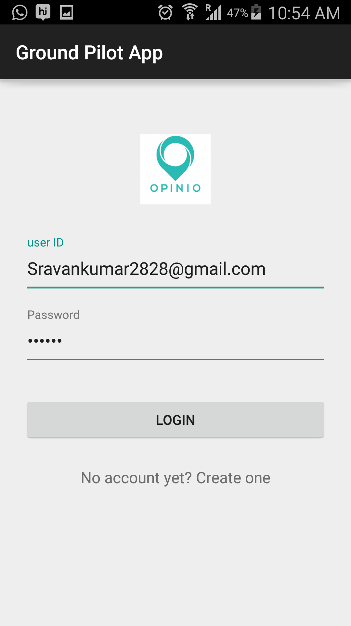
Login Screen

Slide 3
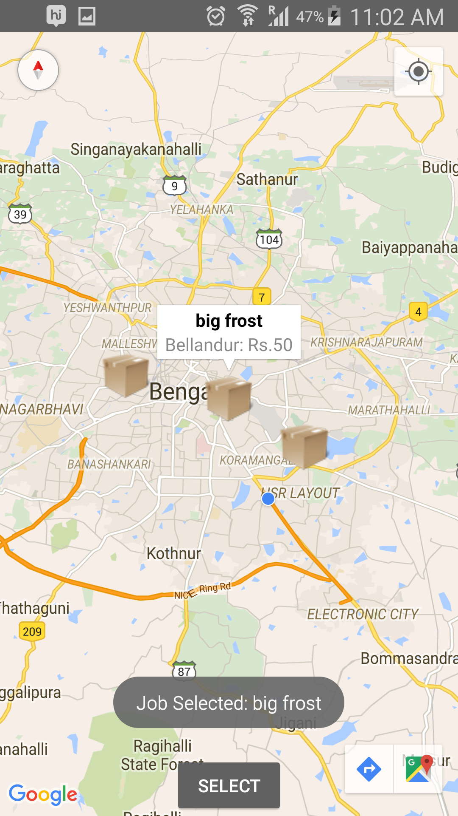
Available pickups
Select pickups

Slide 4
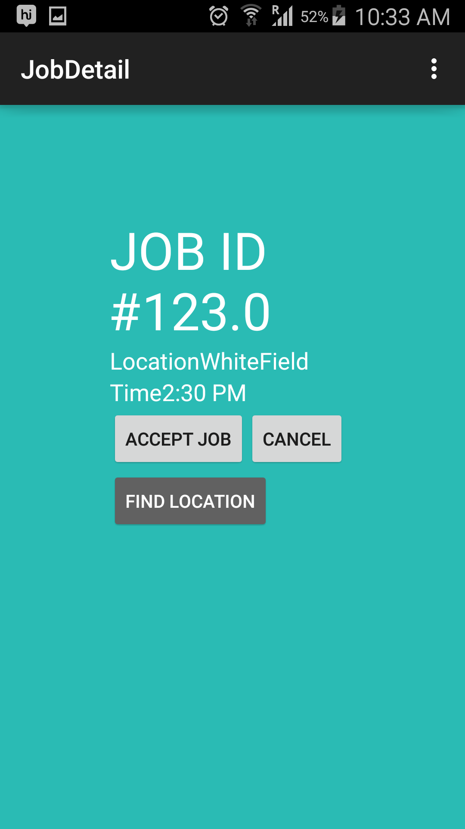
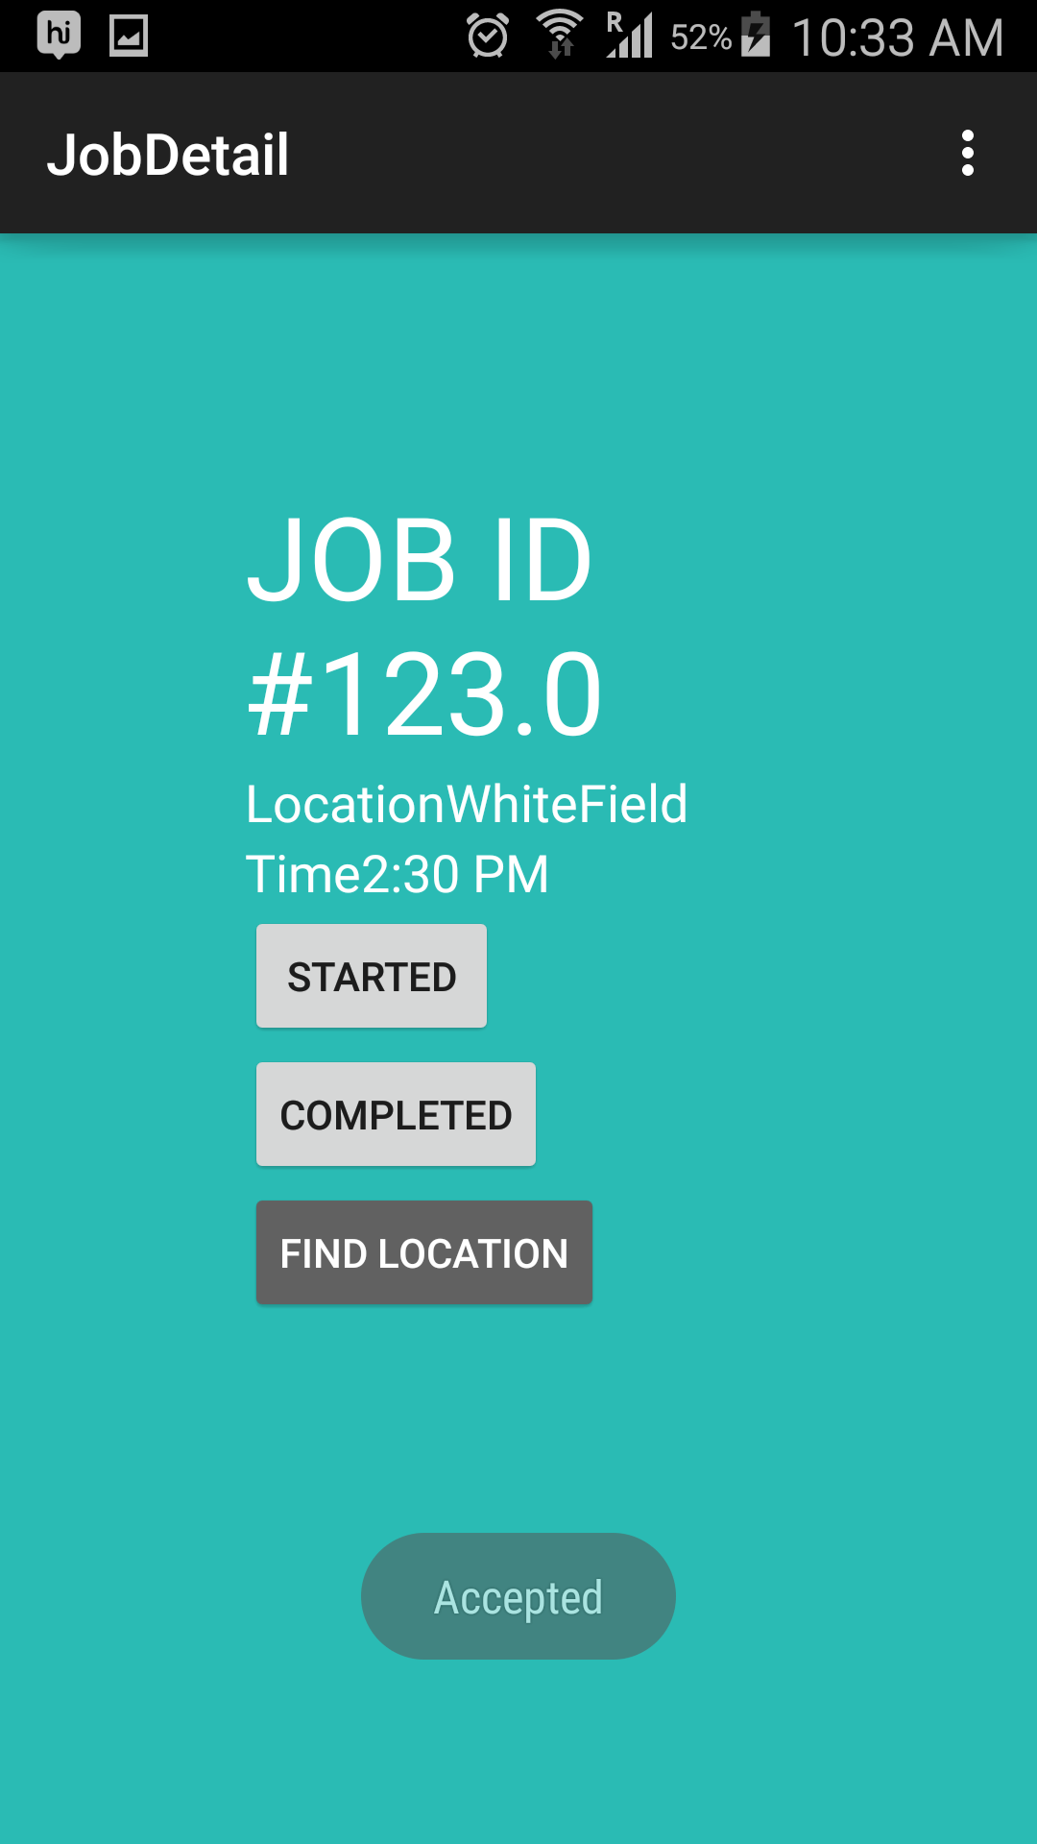
Order details
Click on Accept

Slide 5
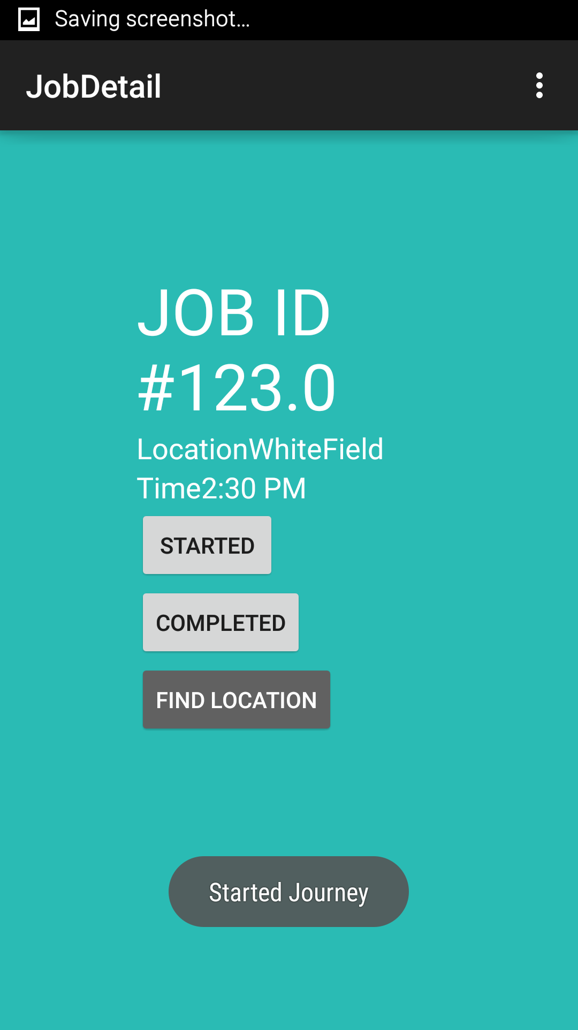
Order picked up

Slide 6
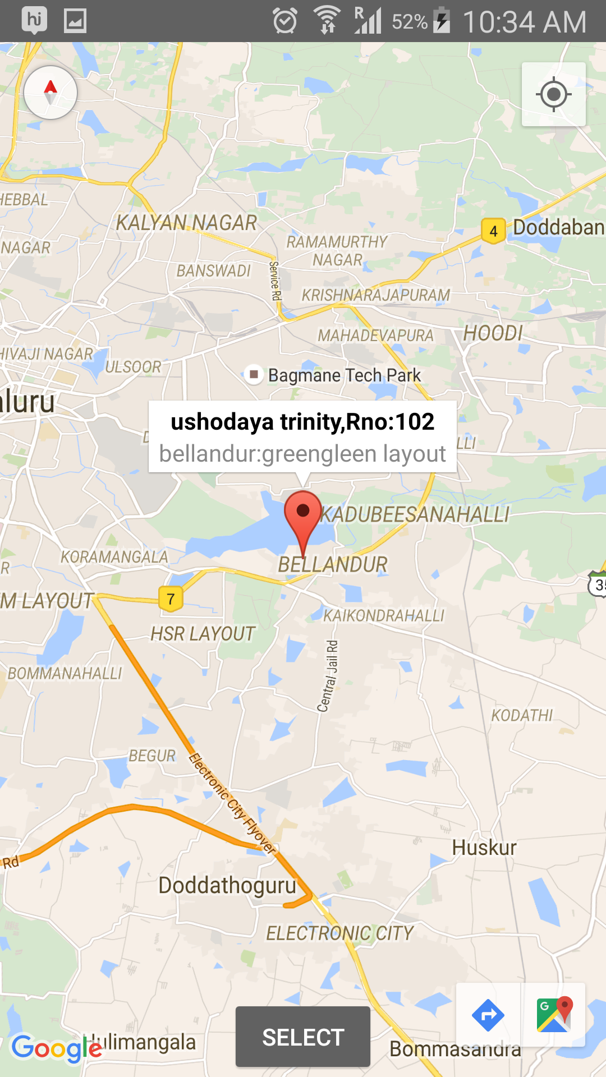
Delivery Location

Slide 7
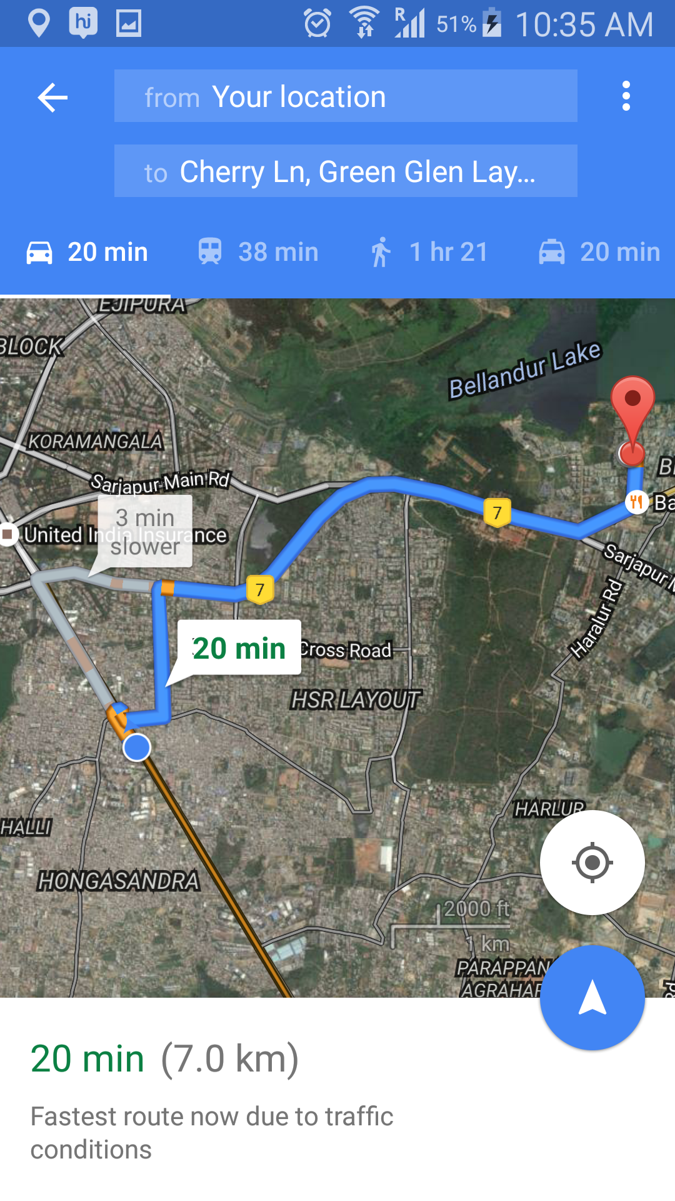
Turn by turn navigation

Slide 8
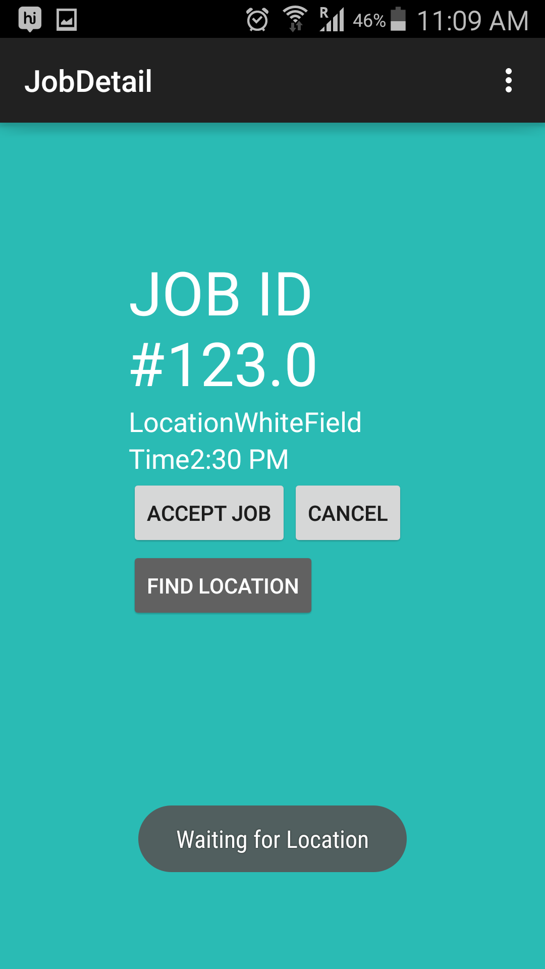
Use find location
If there is no location use find address to get delivery location

Slide 9
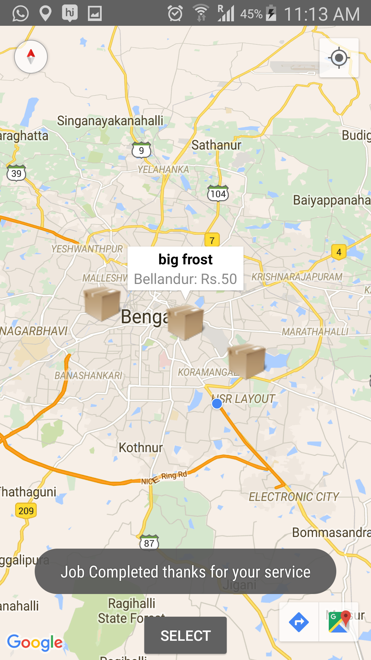
Order completed

